Slide 1
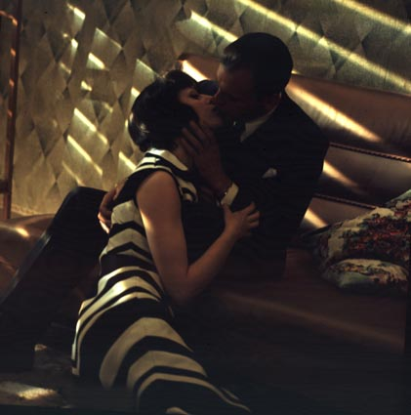
Lighting

Slide 2
Work-in-progress! Grip and Electric positions should go on this slide
http://www.dailymotion.com/video/xhnj36_stagehand-tv-life-of-a-gaffer-lighting-department_tech
Wrapping cable:

Slide 3
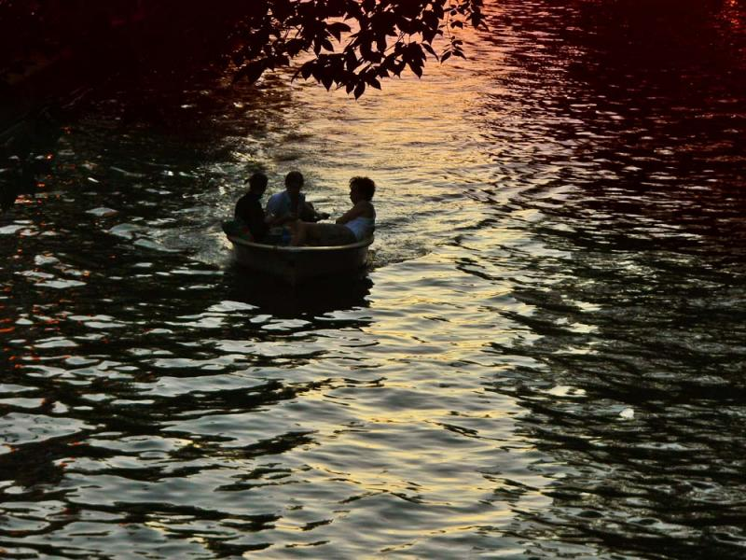
Common Lighting Terminology
Ambient Light - The light already present in a scene, before any additional lighting is added.
Incident Light - Light falling on the object
Reflected Light - Light seen after having bounced off a surface.

Slide 4
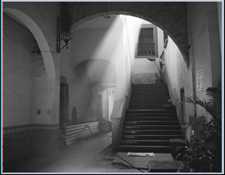
THE PROPERTIES OF LIGHT Any source of light can be described in terms of four properties: Intensity—Light can range from intense (sunlight) to subdued (match light). Generally, we discuss different intensities of light in quantified terms of stops. Color—Light has a color balance, which is dependent on the source (daylight, tungsten). Quality—Hardness (directness) or softness (diffuseness) of the light is referred to as quality. Angle—The angle of the source, relative to the reflective object or subject, affects intensity and quality.

Slide 5
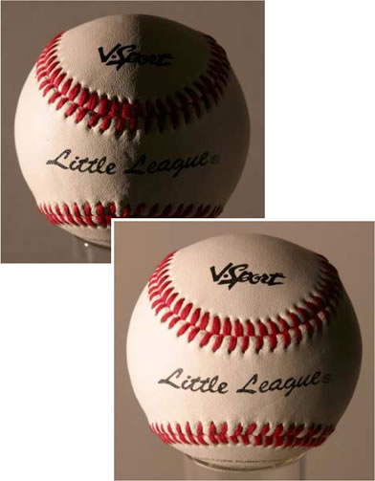
Hard Light - Light directly from a source such as the sun, traveling undisturbed onto the subject being lit.
Soft Light - Light which appears to "wrap around" the subject to some degree. Produces less or softer shadows.

Slide 6
There are two basic lighting philosophies: Naturalism follows the logical positioning of light sources in a scene and is often referred to as motivated lighting. Pictorialism allows the use of light angles that violate Naturalism’s logic for artistic effect.

Slide 7
Naturalism is lighting that follows the logical positioning of light sources in a scene. For example, when photographing two people facing each other in an exterior daylight scene, if one person is in backlight, the other person must be in full sunlight.
The cinematographer will ask the question, "Where is the light coming from
and can I justify this light source?" They will then position lighting units which
will appear to mimic a logical light source. Often the key light is cheated in
order to provide a more flattering or interesting light on the actor.
This is not the same as using only practical light sources to light the scene
such as in Kubrick’s Barry Lyndon.

Slide 8
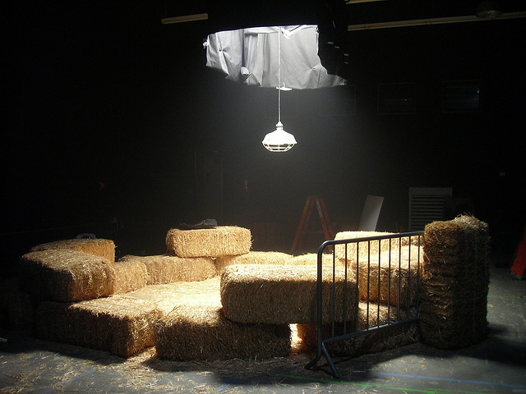
motivated lighting

Slide 9
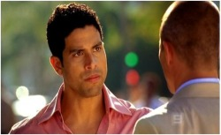
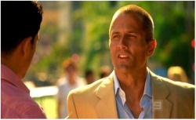
Pictorialism is lighting by way of using light angles which violate the logic
of motivated lighting sources. This is often done to achieve a more pleasing
image or to give the perception of depth to a set.
For example, two opposing people might be backlit in a full-sun scene.
Although this is not realistic, it satisfies the cinematic intention. Show The Conformist

Slide 10
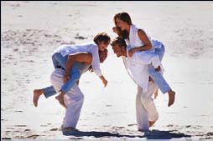
There are two basic styles of lighting: High-key lighting is predominantly bright and allows few dark areas or shadows within the scene. This kind of lighting features strong illumination on the subject and often an equally exposed background. Low-key lighting enhances depth by using contrasting tones of highlights and shadow. Only a few areas are lit at or above key, resulting in more shadow areas. This ratio creates the low-key effect.

Slide 11
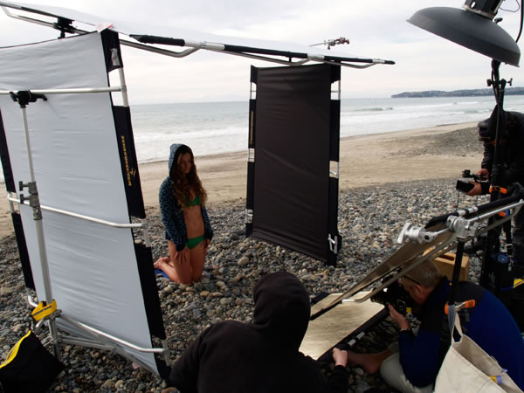
ADDITIVE AND SUBTRACTIVE LIGHT In exterior daylight settings, we may have too much light filling our subject. To compensate, we often use a technique called subtractive lighting. We use negative fill, which is the removal of some of the quantity of light to control shadows of varying densities.

Slide 12
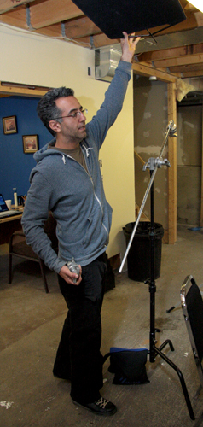
Flag - blocks light

Slide 13
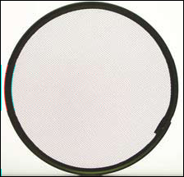
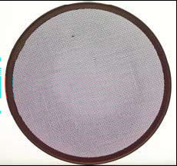
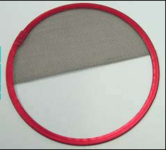
Scrims, usually made of metal mesh and mounted to the lights, can be used to reduce the intensity of light. A single scrim cuts the light by half a stop; a double scrim cuts light by a full stop.

Slide 14
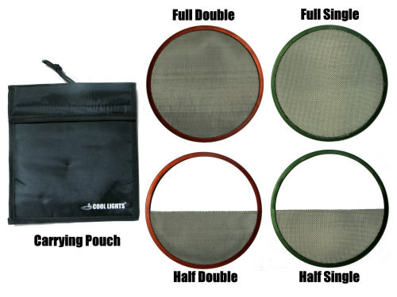
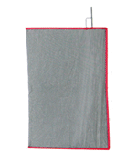
Scrim - reduces light, but does not soften it
“Net” with scrim material

Slide 15
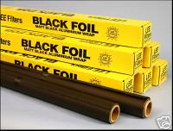
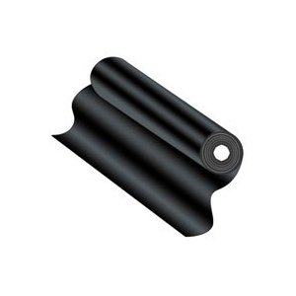
Black Wrap

Slide 16
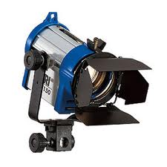
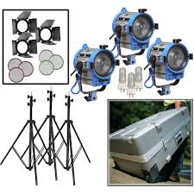
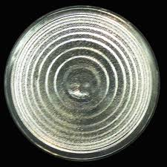
ADDITIVE AND SUBTRACTIVE LIGHT Additive lighting is probably more familiar. When we add light, we often use electric lamps. But we can also use reflectors, bounce boards, and other tools to redirect light so that it falls on the subject. In so doing, we add light.
Fresnel lens
Arri Kit
Notes:
Fresnel instruments allow the lamp to be moved relative to the lens' focal point, to increase or decrease the size of the light beam. As a result, they are very flexible, and can often produce a beam as narrow as 7° or as wide as 70°.^{[13]} The Fresnel lens produces a very soft-edged beam, so is often used as a wash light. A holder in front of the lens can hold a colored plastic film (gel) to tint the light or wire screens or frosted plastic to diffuse it. The Fresnel lens is useful in the making of motion pictures not only because of its ability to focus the beam brighter than a typical lens, but also because the light is a relatively consistent intensity across the entire width of the beam of light.

Slide 17
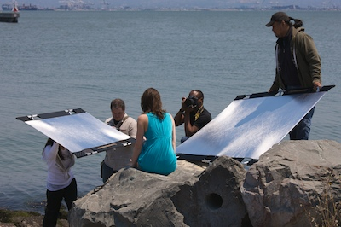
Reflector board, typically foam core and beadboard, is often positioned to bounce light where needed.
Notes:
Cinematographers typically combine the techniques of additive and subtractive lighting in order to control and manipulate a scene’s contrast.

Slide 18
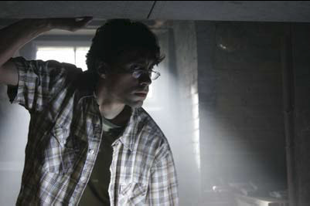
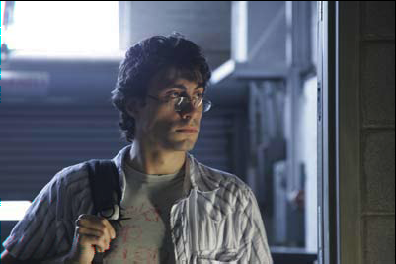
To create a convincing three-dimensional image, the subjects and layers of the scene must be separated from each other. This is accomplished with light or color, creating contrasts of light against dark or dark against light, and by strategic placement of color. The cinematographer must consider how light falls on and around actors; how colors bounce off objects and reflect onto faces, and where the highlights and shadows are.
Creating Dimension

Slide 19
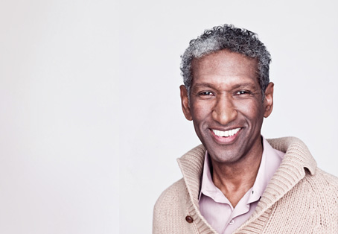
Soft light can be created by:
Bouncing the light
Using diffusion material (silk)
Pulling the light away from the subject

Slide 20
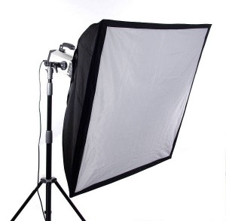
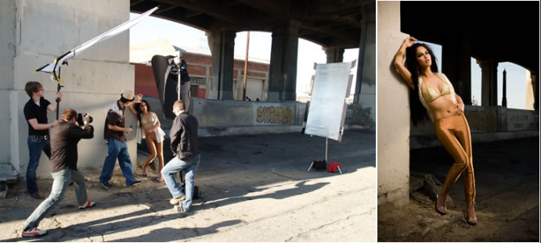
Silks - diffuse light To diffuse is to spread, soften

Slide 21
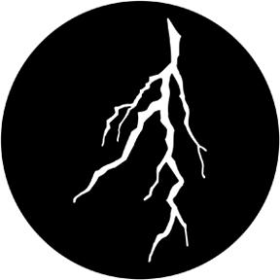
Cucoloris or “Cookie” - patterned light

Slide 22
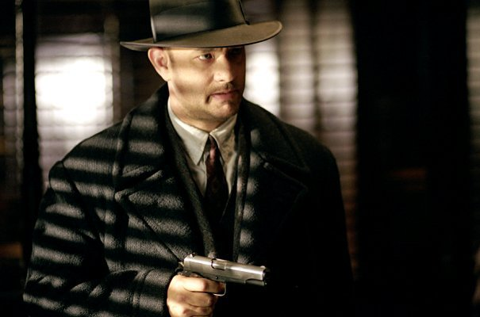
Cucoloris or “Cookie” - patterned light

Slide 23
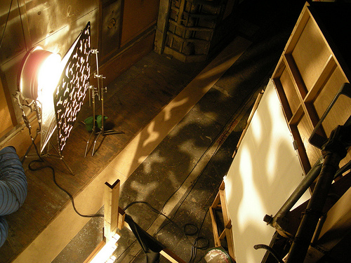
Cucoloris or “Cookie” - patterned light

Slide 24
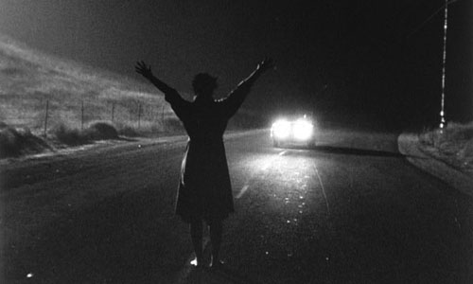
Practical light

Slide 25
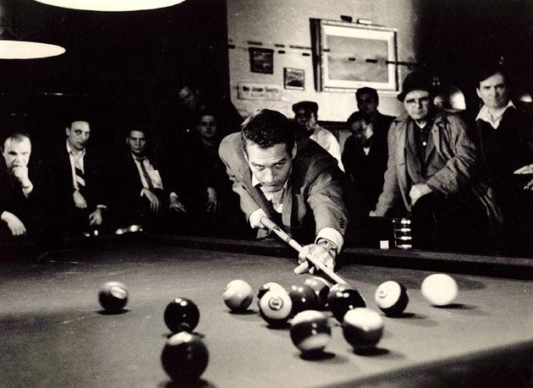
Practical light

Slide 26
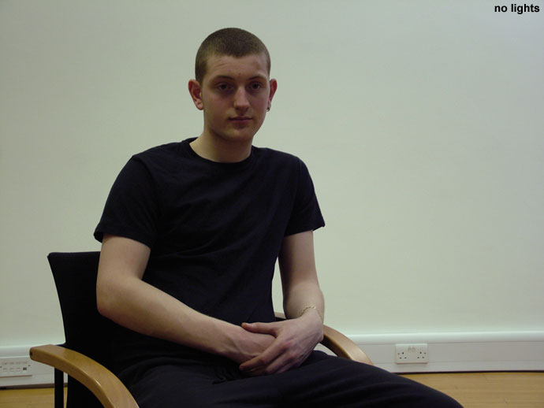
3 Point Lighting is a classic lighting technique which uses 3 basic lights to illuminate the subject; the key, fill and backlight. Each light has a particular function. Even if many lights are used to cover a large set, each light plays one of these three roles.

Slide 27
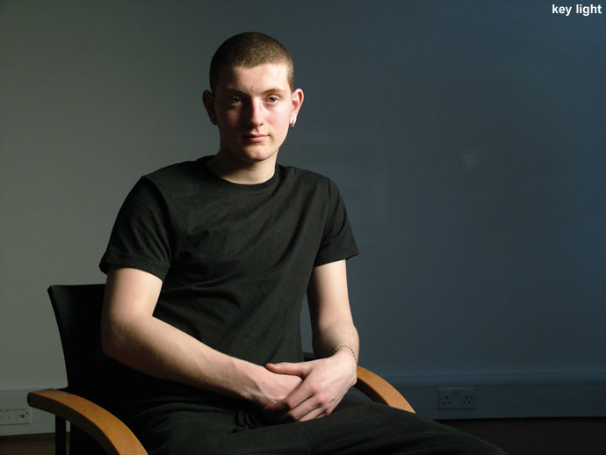
3 Point Lighting
Key Light - The main light on the subject, providing most of the illumination and contrast.

Slide 28
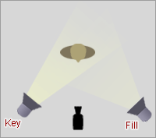
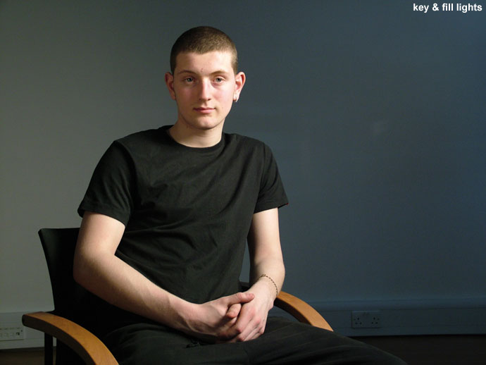
3 Point Lighting
Fill Light - A light placed to the side of the subject to fill out shadows and balance the key light.

Slide 29
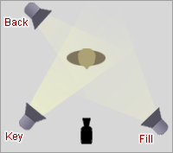
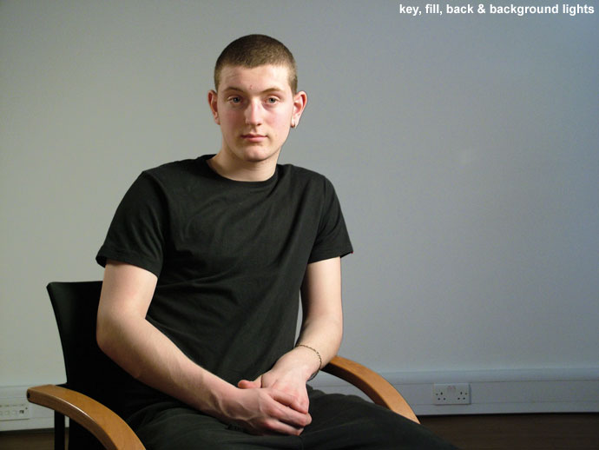
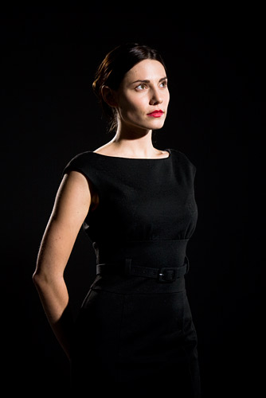
3 Point Lighting
Back Light - A light placed at the rear of a subject to light from behind.
(also called a rim light or kicker)

Slide 30
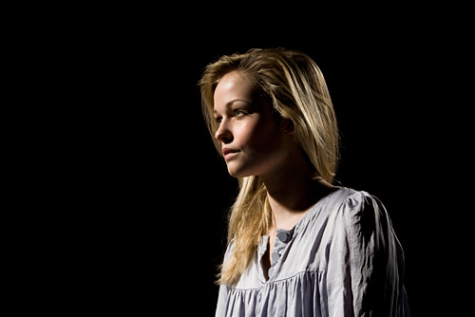
3 Point Lighting
Key Light and Back Light

Slide 31
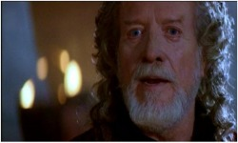
Eyelight
Eyelight is any light used to produce added sparkle to the eye of an actor. The sparkle is a reflection on the surface of the eye.
It is created by placing a bright surface at a point where it will create a virtual image on the eye for the camera to pick up.

Slide 32
In-class Exercise:
Set-up #1 - Rembrandt lighting
Set-up #2 - 3 Point lighting
Set-up #3 - Cross lighting

Slide 33
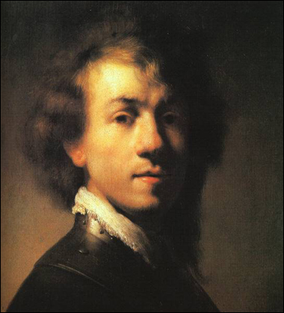
Rembrandt Lighting
Rembrandt lighting is a technique that
is sometimes used in studio portrait
photography. It can be achieved using
one light and a reflector. It is capable
of producing images which appear
both natural and compelling with a
minimum of equipment.
Rembrandt lighting is characterized
by an illuminated triangle under the
eye of the subject, on the less
illuminated side of the face.
It is named for the Dutch painter
Rembrandt, who often used this type
of lighting.
Movie director Cecil B. DeMille is
credited with the first use of the term.

Slide 34
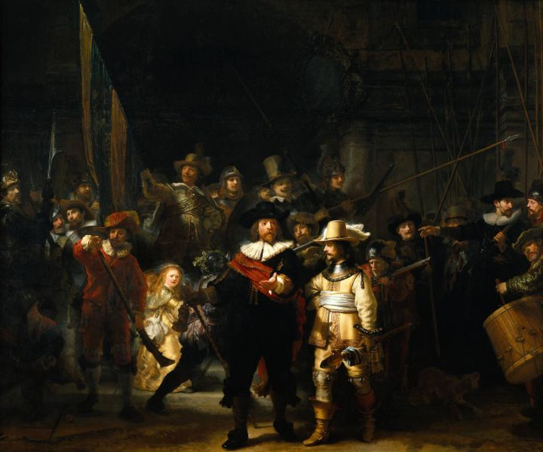

Slide 35
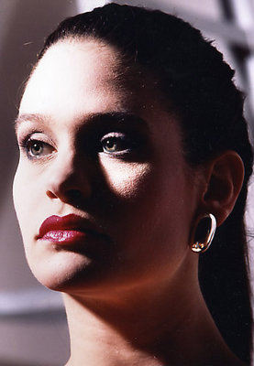
The triangle should be no longer than
the nose and no wider than the eye.
This technique may be achieved subtly
or very dramatically by altering the
distance between subject and light
and relative strengths of the key and reflected light.

Slide 36
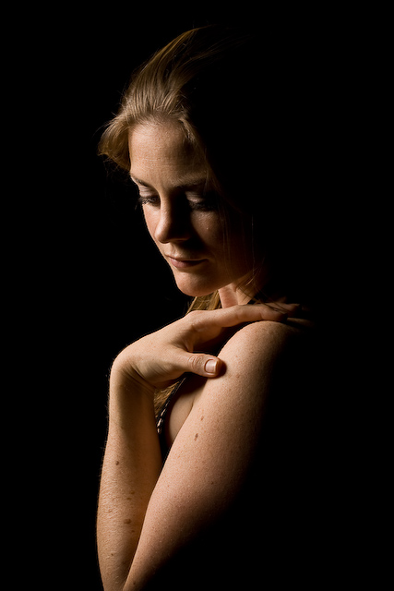
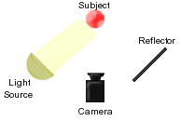

Slide 37
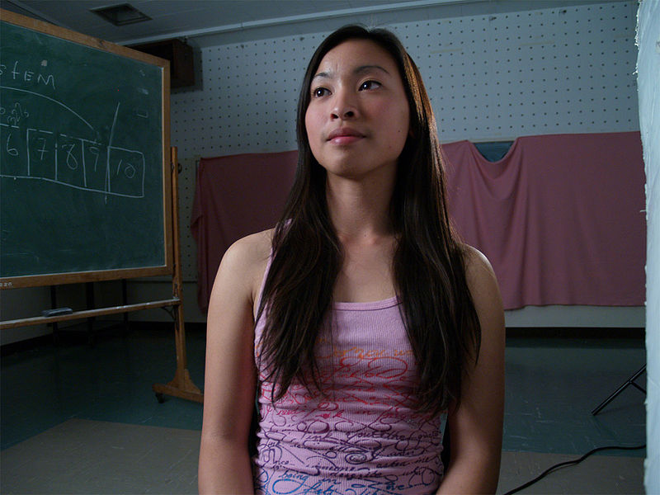
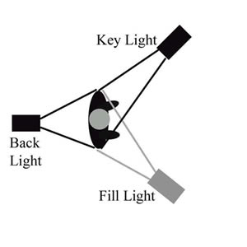
3 Point Lighting

Slide 38
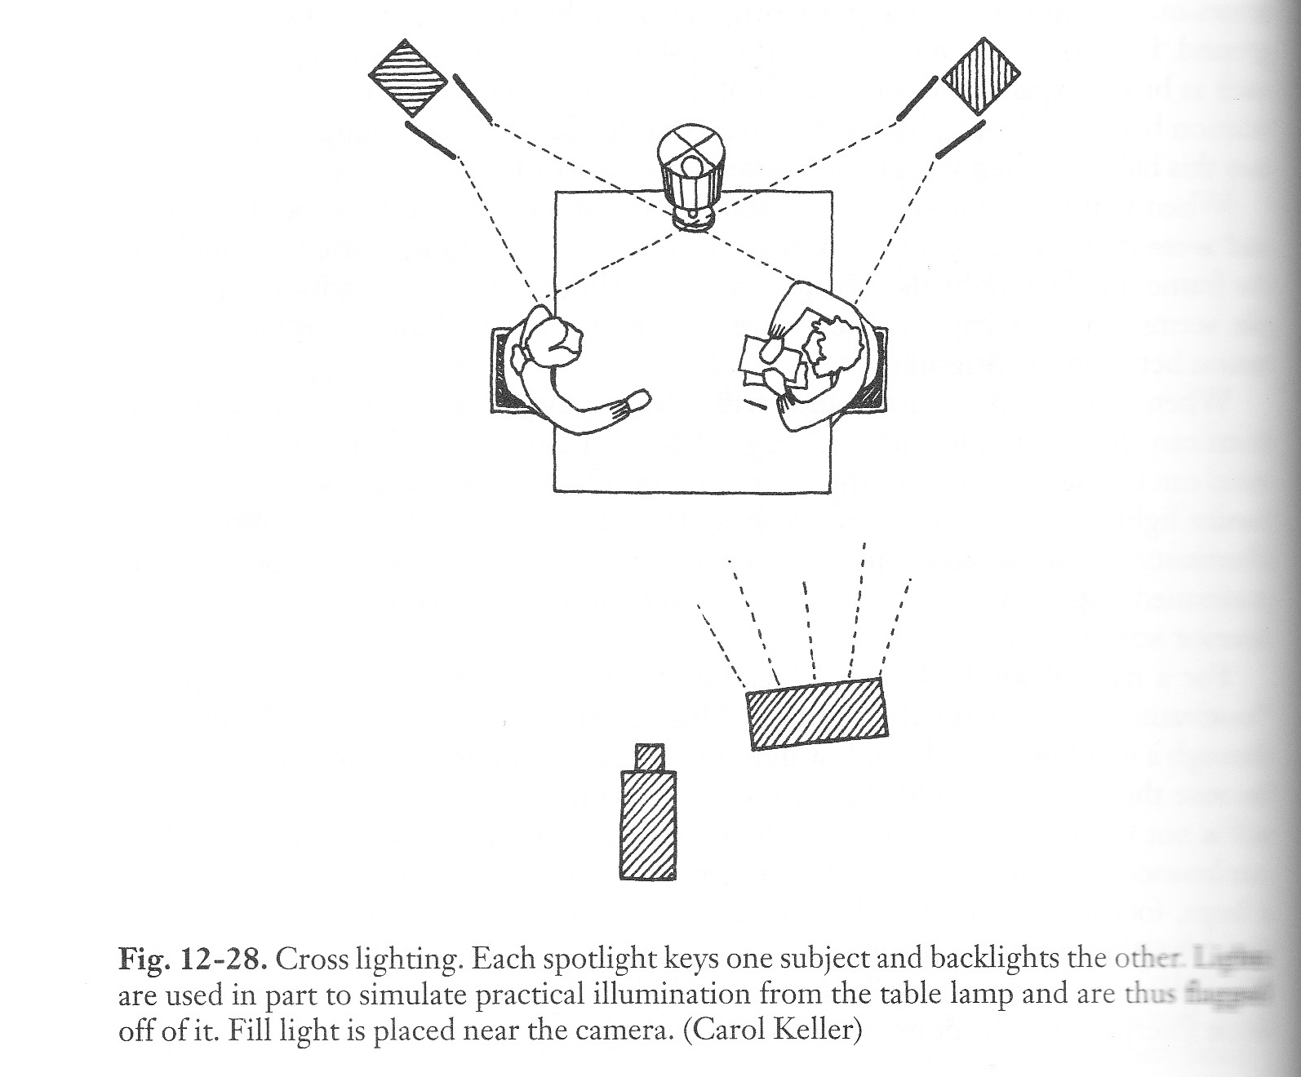
Cross Lighting

