Slide 1
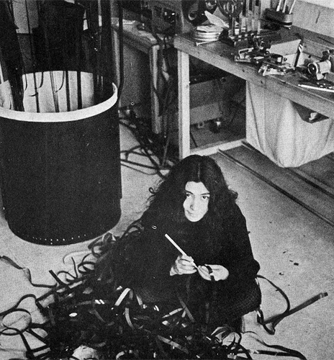
Editing
Part 1: Devices

Slide 2
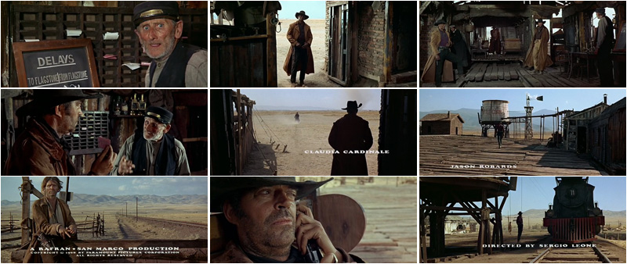
Film editing is the connecting of one or more shots to form a sequence, and the subsequent connecting of sequences to form an entire movie. Film editing is unique to cinema and separates filmmaking from all other art forms that preceded it (such as photography, writing, and theater directing).
Once Upon a Time in the West, 1968, Sergio Leone

Slide 3
Early films by Thomas Edison and others were short films that were one long, static camera shot. Motion within the shot was all that was necessary to amuse an audience. There was no story or editing.
1894-98

Slide 4
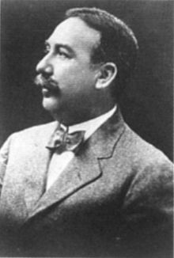
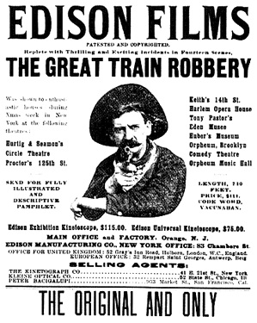
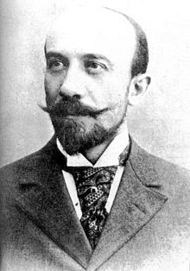
Edwin S. Porter (1870–1941), employed by Edison, is generally thought to be the American filmmaker who first put film editing to use in, Life of an American Fireman (1903). (doc)
Georges Méliès (1861–1938), was a French filmmaker famous for leading many technical developments in cinema. He was one of the first to use multiple exposures, time-lapse photography, dissolves, and hand-painted color in his work.
A Trip to the Moon (1902) hand-colored clips

Slide 5
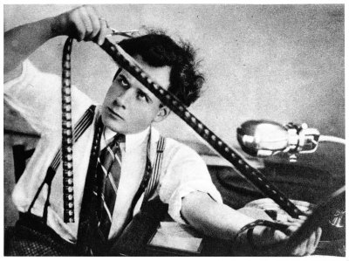
Film editing is an art form which can make or break a film. “A film editor works with the layers of images, the story, the music, the rhythm, the pace, shapes the actors' performances, "re-directing" and often re-writing the film during the editing process, honing the infinite possibilities of small snippets of film into a creative, coherent, cohesive whole.” (Knight, 1957, p.25)

Slide 6
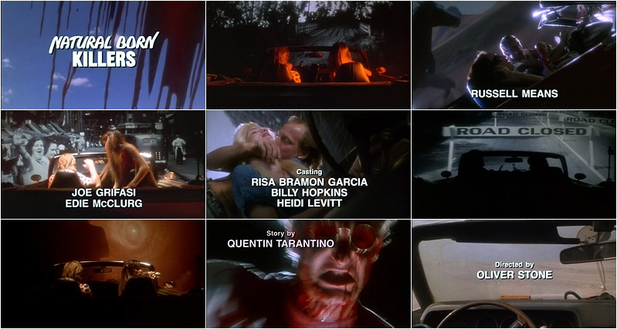
Transitions/Cuts
A cut is a visual transition in editing in which one shot is replaced on screen by another. A Hollywood film typically contains thousands of cuts.

Slide 7
Types of cuts: Straight cut Jump Cut Cut-In, Cut-Away Crosscutting/Parallel Editing Shot/Reverse Shot Split edit (J and L cuts)

Slide 8
A jump cut is the elimination of a strip of insignificant action from a continuous shot or a disconcerting joining of two shots that do not match in action and continuity. Either the figures seem to change instantly against a constant background, or the background changes instantly while the figures remain constant.
The Shining, 1980, Stanley Kubrick

Slide 9
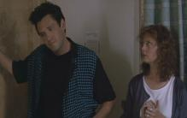
Crosscutting or parallel editing alternates shots of two or more lines of action occurring in different places, usually simultaneously. The two actions are therefore linked, associating the characters from both lines of action.
Thelma & Louise, 1991 (exploring/contrasting characters)
The Silence of the Lambs, 1991 (developing plot, playing with expectations)

Slide 10
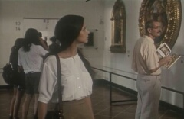
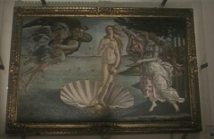
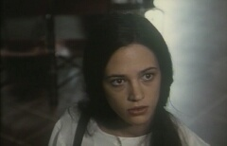
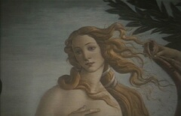
Shot/reverse shots are one of the most firmly established conventions in cinema, and they are usually linked through the equally persuasive eyeline matches. These conventions have become so strong that they can be exploited to make improbable meanings convincing, as in this sequence where it seems as if Venus is looking at Anna.
The Stendhal Syndrome (1996), Dario Argento

Slide 11
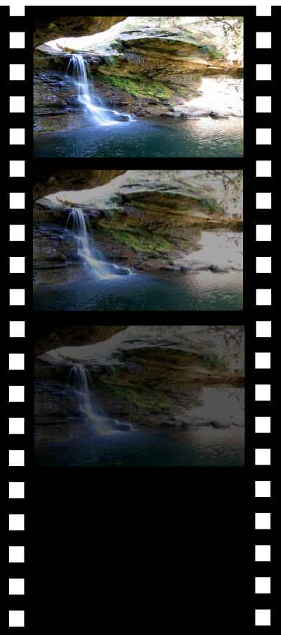
Unlike the cut, the transition attempts to blend two shots together, rather than simply joining them end to end. Often transitions are used to imply a passage of time. Transition devices include: Dissolve Fade in/out Wipe

Slide 12
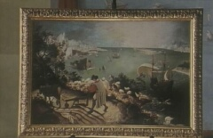
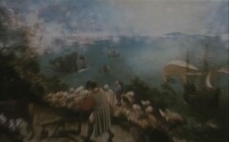
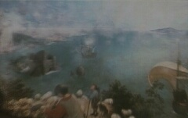
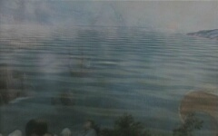
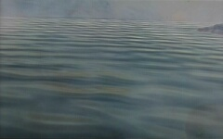
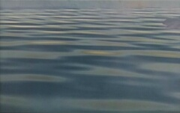
Dissolves can be used as a fairly straightforward editing device to link any two scenes, or in more creative ways, for instance to suggest hallucinatory or dream states.

Slide 13
A wipe transition has a line that passes across the screen, eliminating the first shot and replacing it with the next one. A very dynamic and noticeable transition, it is usually employed in action or adventure films.
Kurosawa's Seven Samurai (1954)

Slide 14
A graphic match edit is two successive shots joined so as to create a strong similarity of compositional elements (e.g., color, shape), which creates a smooth transition.
Matches
Match cut devices include:
Graphic Match
Matched Action
Eyeline Match
Women On The Verge Of A Nervous Breakdown (1988)

Slide 15
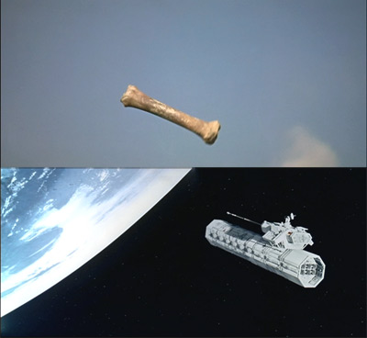
A graphic match often helps to establish a strong continuity of action and can link the two shots metaphorically.
Graphic Match cut of a bone-club and an orbital nuclear weapons platform from:
2001: A Space Odyssey, 1968, Kubrik

Slide 16
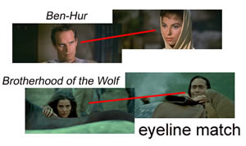
The eyeline match begins with a character looking at something off-screen, there will then be a cut to the object or person at which he is looking.

Slide 17
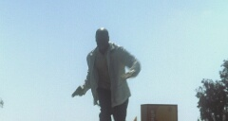
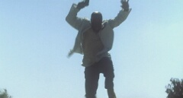
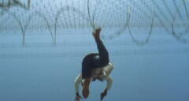
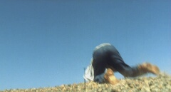
A match on action cut splices different views of the same action together at the same moment in the movement, making it seem to continue uninterrupted.
Traffic (2000)

Slide 18
Matched action edits add variety and dynamism to a scene, since it conveys two movements: the one that actually takes place on screen, and an implied one by the viewer, since her/his position is shifted.

Slide 19
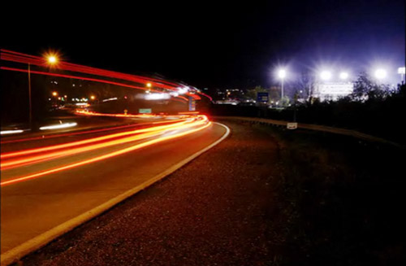
Duration
The decision to extend a shot can be as significant as the decision to cut it. Editing can affect the experience of time in the cinema by creating a gap between screen time (what we see) and diegetic time (how long it would actually take) or by establishing a fast or slow rhythm for the scene.

Slide 20
Overlapping editing uses cuts that repeat part or all of an action, thus expanding its viewing time and plot duration. Overlapping editing is a common characteristic of the frenzied Hong Kong action films of the 80s and 90s. When director John Woo moved to Hollywood, he tried to incorporate some of that style into mainstream action films, such as Mission: Impossible 2 (2000).

Slide 21
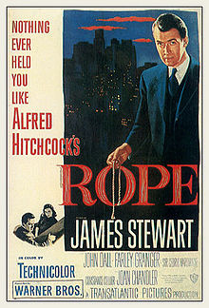
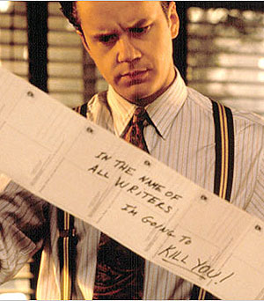
A long take continues for an unusually lengthy time before the transition to the next shot. In general, any shot longer one minute can be considered a long take. Sophisticated long takes include all kinds of camera movements and zooms, and are often seen as directorial marks of virtuosity. Long takes decisively influence a film's rhythm. Depending on how much movement is included, a long take can make a film tense, stagnant and spell-binding, or daring, flowing and carefree.
Rope, 1948
- real time
- all long takes
- cut to seem as if the entire film was shot in one take
Robert Altman's The Player (1992) opens with a long take (8 min.), and is in itself an homage to another famous long take, the first shot of Orson Welles's Touch of Evil (1958).

Slide 22
RHYTHM In The Good, the Bad and the Ugly (1966) as three men face each other in a triangle, the film's theme songs is played. The slow mounting crescendo is paralleled by an increase in the editing rate, and an intensified framing.

Slide 23
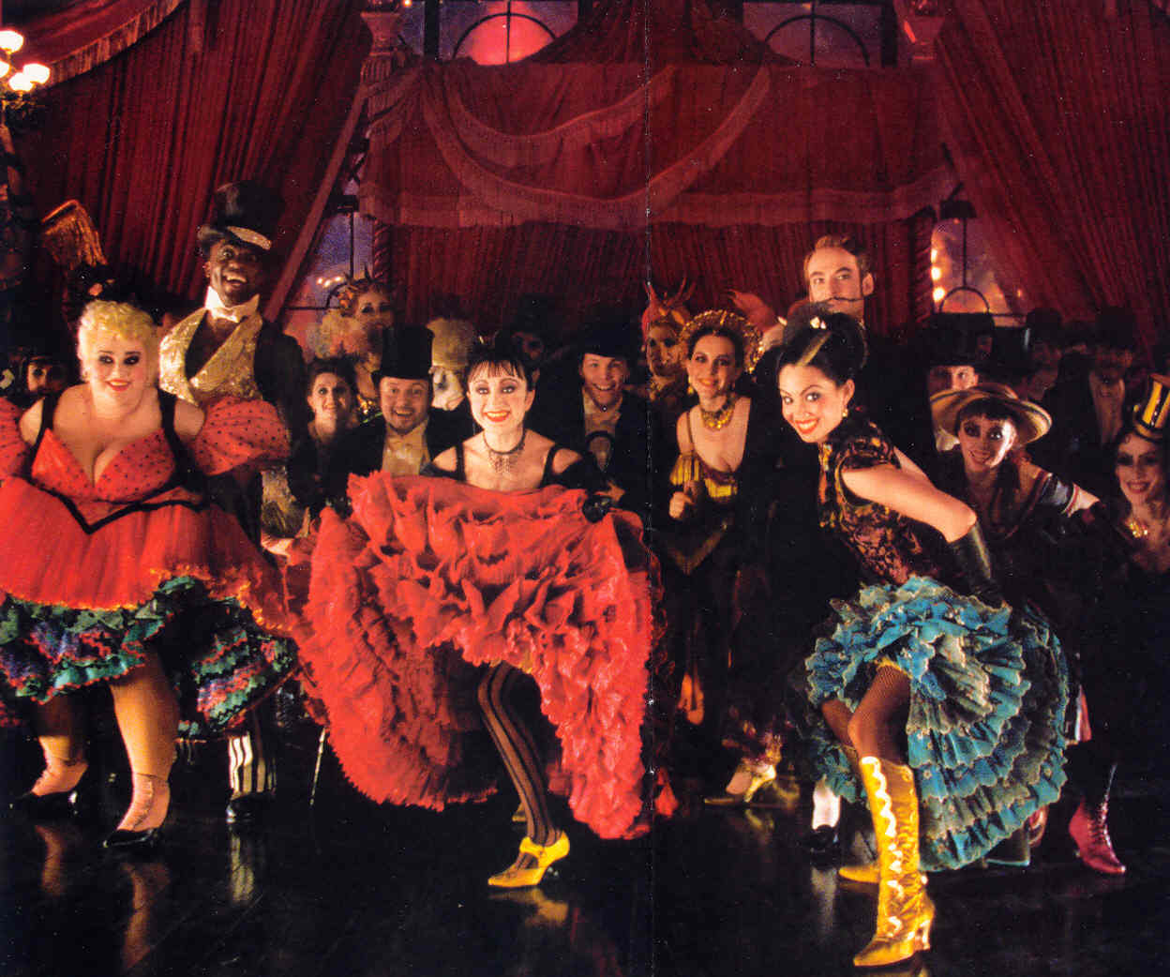
RHYTHM The perceived rate and regularity of sounds, series of shots, and movements within the shots. Rhythm is one of the essential features of a film, for it decisively contributes to its mood and overall impression on the spectator. It’s achieved through the combination of mise-en-scene, cinematography, sound and editing. Rhythm can be understood as the final balance all of the elements of a film. (screen Moulin Rouge, expand later)

Slide 24
Sources:
Dmytryk, Edward. On Film Editing: An Introduction to the Art of Film Construction, Boston: Focal Press, 1984.
Murch, Walter. In the Blink of an Eye: a Perspective on Film Editing, Silman-James Press, 2d rev. ed., 2001. ISBN 1-879505-62-2
Arthur Knight, The Liveliest Art, Mentor Books, New American Library, 1957, p. 25
http://classes.yale.edu/film-analysis/htmfiles/intro.htm www.tadvin.ir/images/film-editing2.jpg http://en.wikipedia.org/wiki/Eyeline_match

